Slide 1
Assignment 3
Group 9:
Aastha Grover
Neha Gilson
Shuxian Wu

Slide 2
Problem Statement
How can the current energy consumption data be used to monitor ,plan and predict the energy usage for the future.
How can this data be used by business to save money on their energy bills?

Slide 3
Goal
Show the trends in energy consumption by different facilities owned by City of Boston.
Cluster the accounts based on power usage and type(Commercial, Educational etc.) . Analyze which facilities are the best and worst energy consumers in each cluster.
Recommend which facilities need to be monitored and provide suggestion for optimal usage of energy.

Slide 4
Application use case
Using the trends, predict future usage and send it to the provider for deciding energy distribution at the facilities on an hourly and daily basis.
Option to view usage trends on monthly, weekly and daily basis.
Peak hour analysis of daily power consumption.
Application can be used to study the Bad, Good and Perfect power factor for a particular account.

Slide 5
Data Aggregation
Python/R Script
Data Transformation
Python Script
Data Cleansing
Python Script
Model Building
Deploy Model
Visualization
Create Web Service
Azure ML
Azure ML
Tableau

Slide 6
Data Cleansing
We are using python to clean our dataset with models like panda, numpy and datetime.
We fill N/A value with 0 and drop duplicates. Even though we got 0 for some facilities which might because of renovation or any other reason, we plan to keep each facilities one hourly record of kWh, kVARh and Power factor for each day.
Also, think of power consumption, we consider tracking if it is a workingday or not, and same to holiday. We merged historical weather date 2014 from NOAA, focusing on Max and Min temperature for each day.

Slide 7
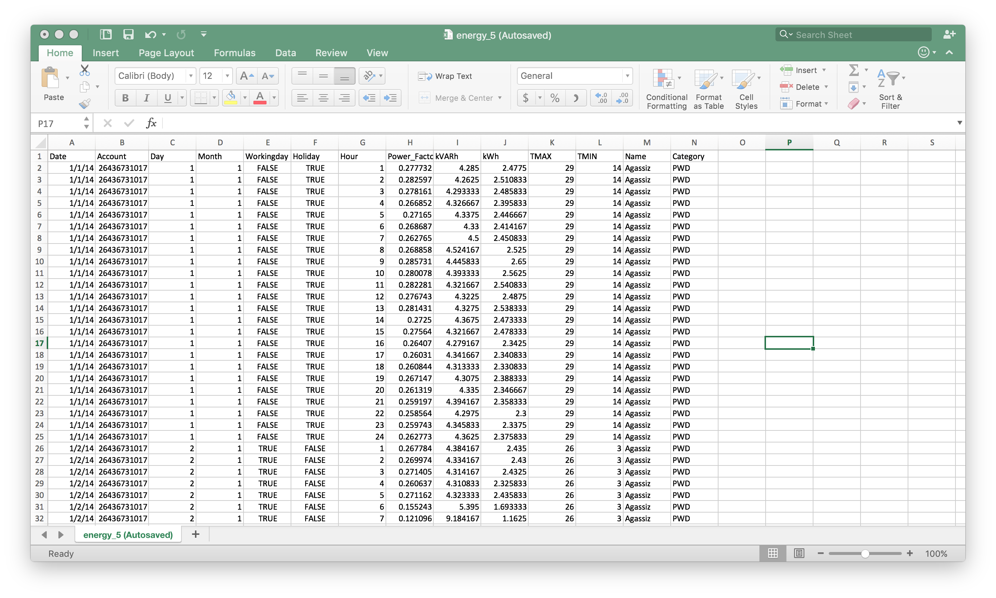
Cleaned Data set

Slide 8
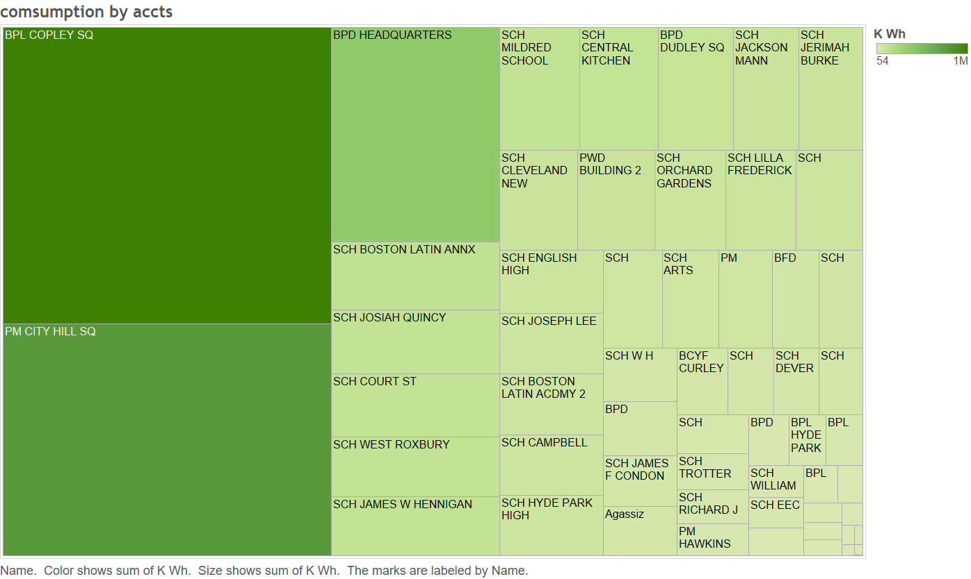
Data Visualization

Slide 9
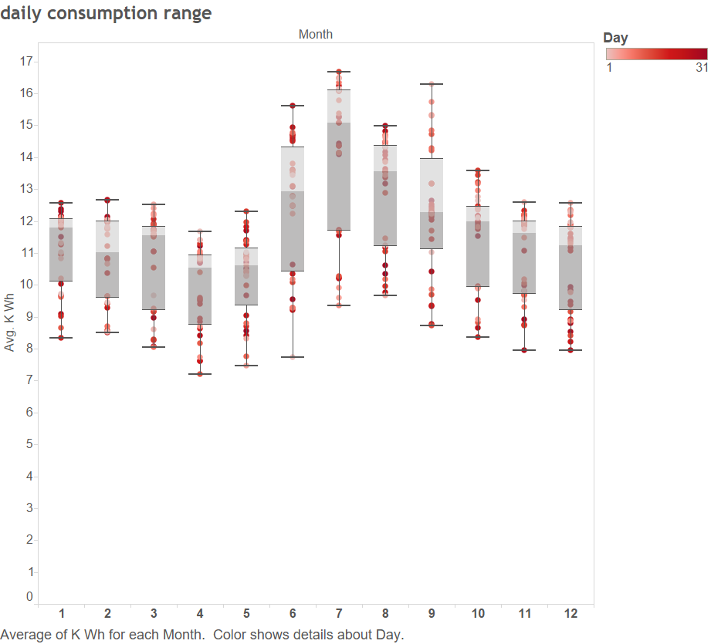
Monthly comsumption range

Slide 10
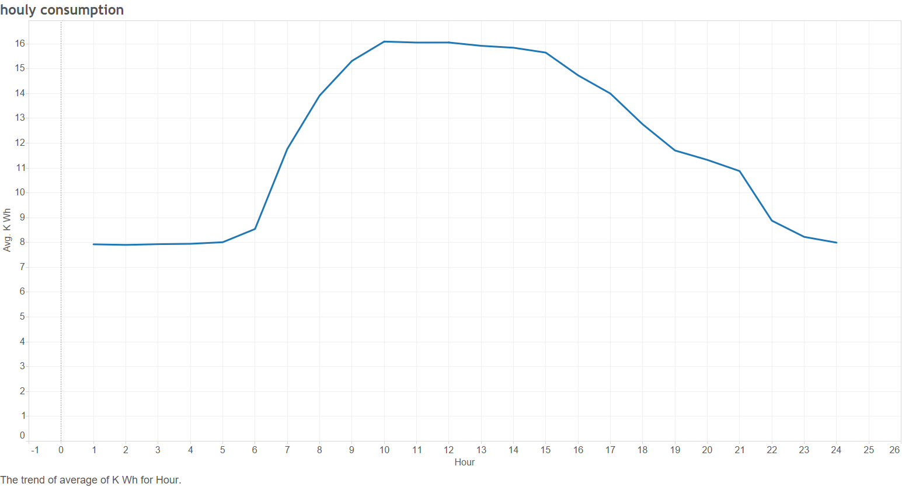
Hourly energy Comsumption

Slide 11
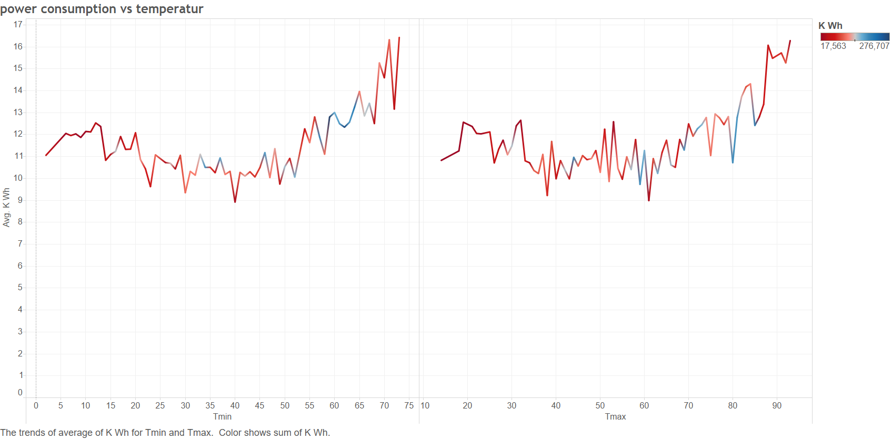
Comparison for the effect Max VS Min temperature

Slide 12
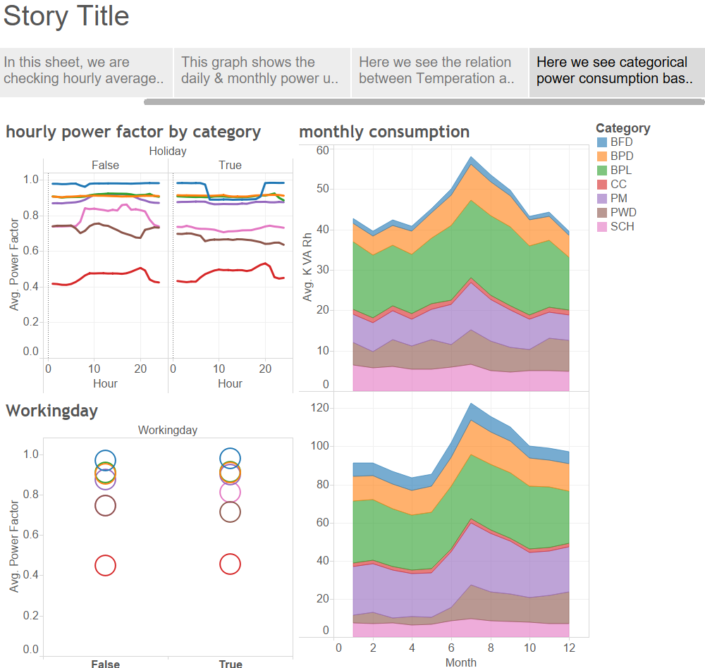
Features by different categories

Slide 13
Prediction

Slide 14
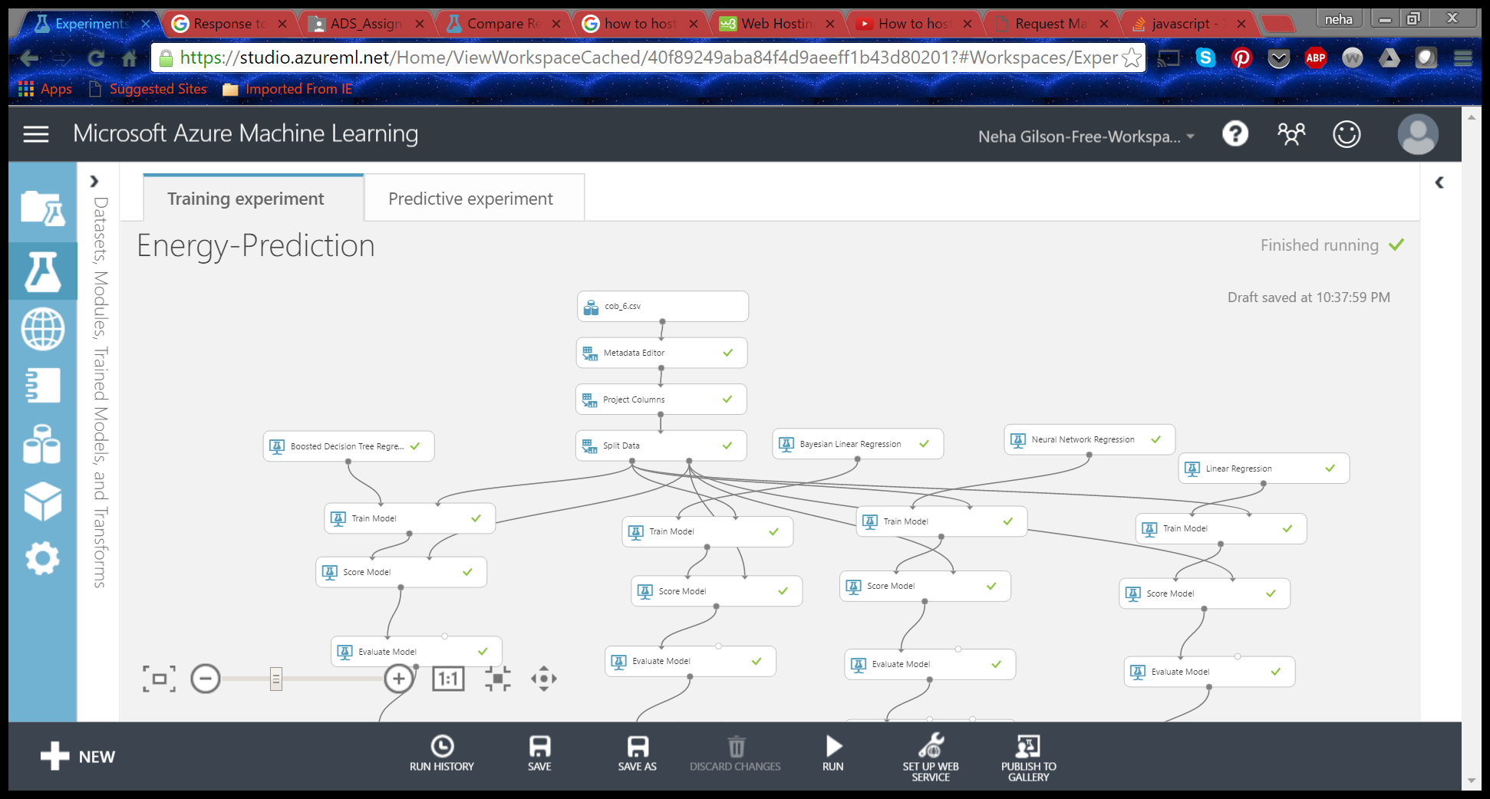
Linear regression Model for Predictive analysis of power consumption

Slide 15
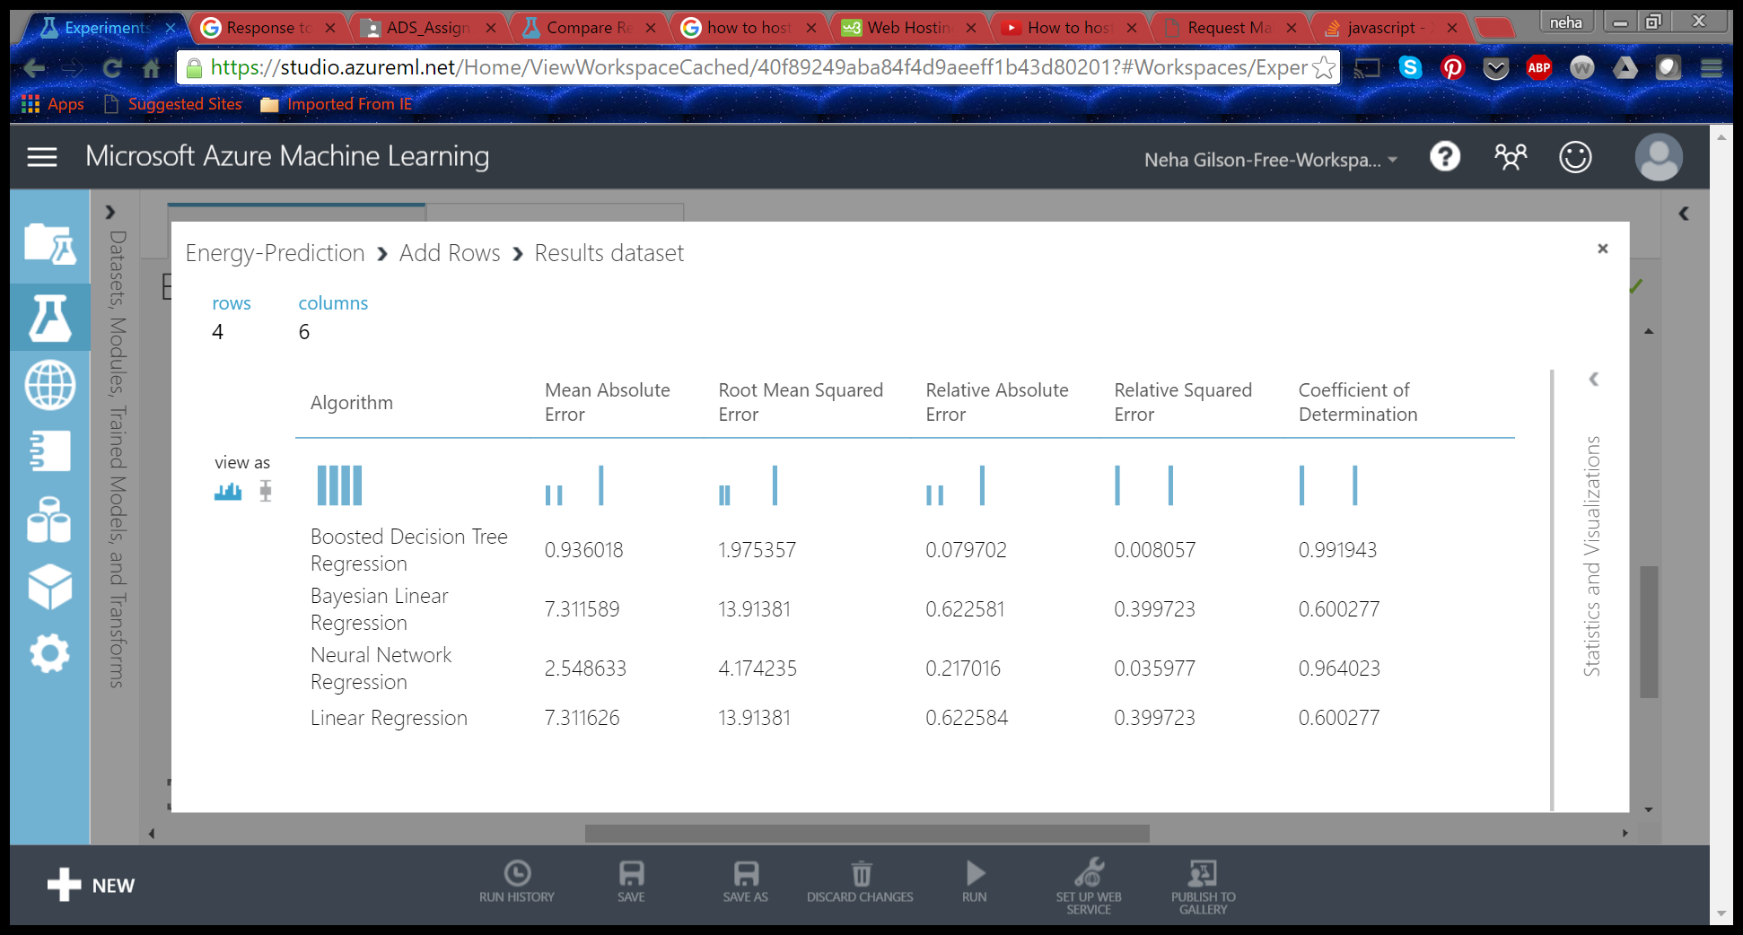
Evaluation

Slide 16
CLUSTERING

Slide 17
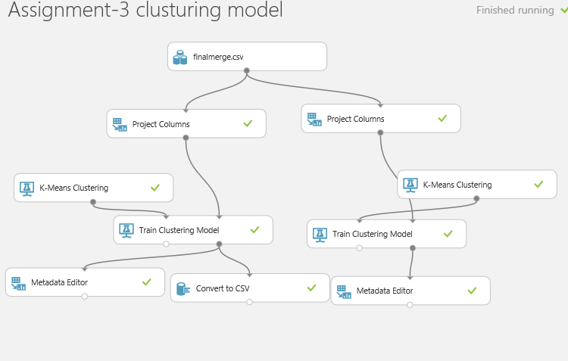

Slide 18
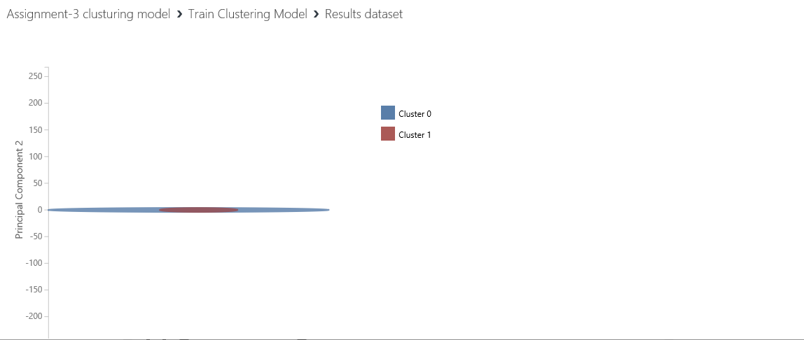
TWO CLUSTERS based on kvarh

Slide 19
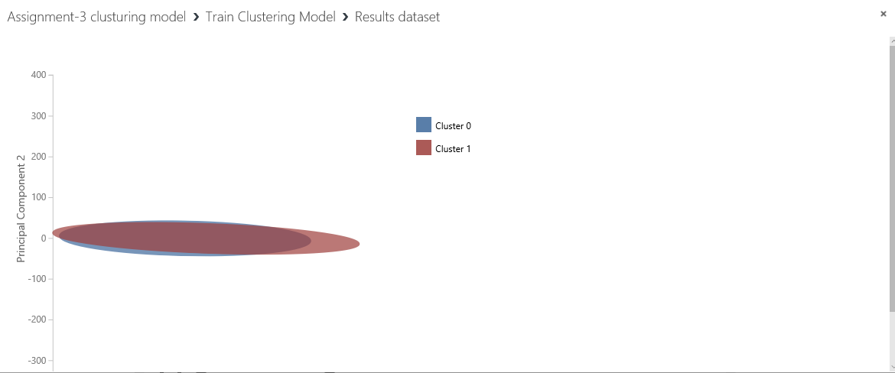
Two clusters based on power consumption and working day/holiday

Slide 20
Thank you!

